Slide 1
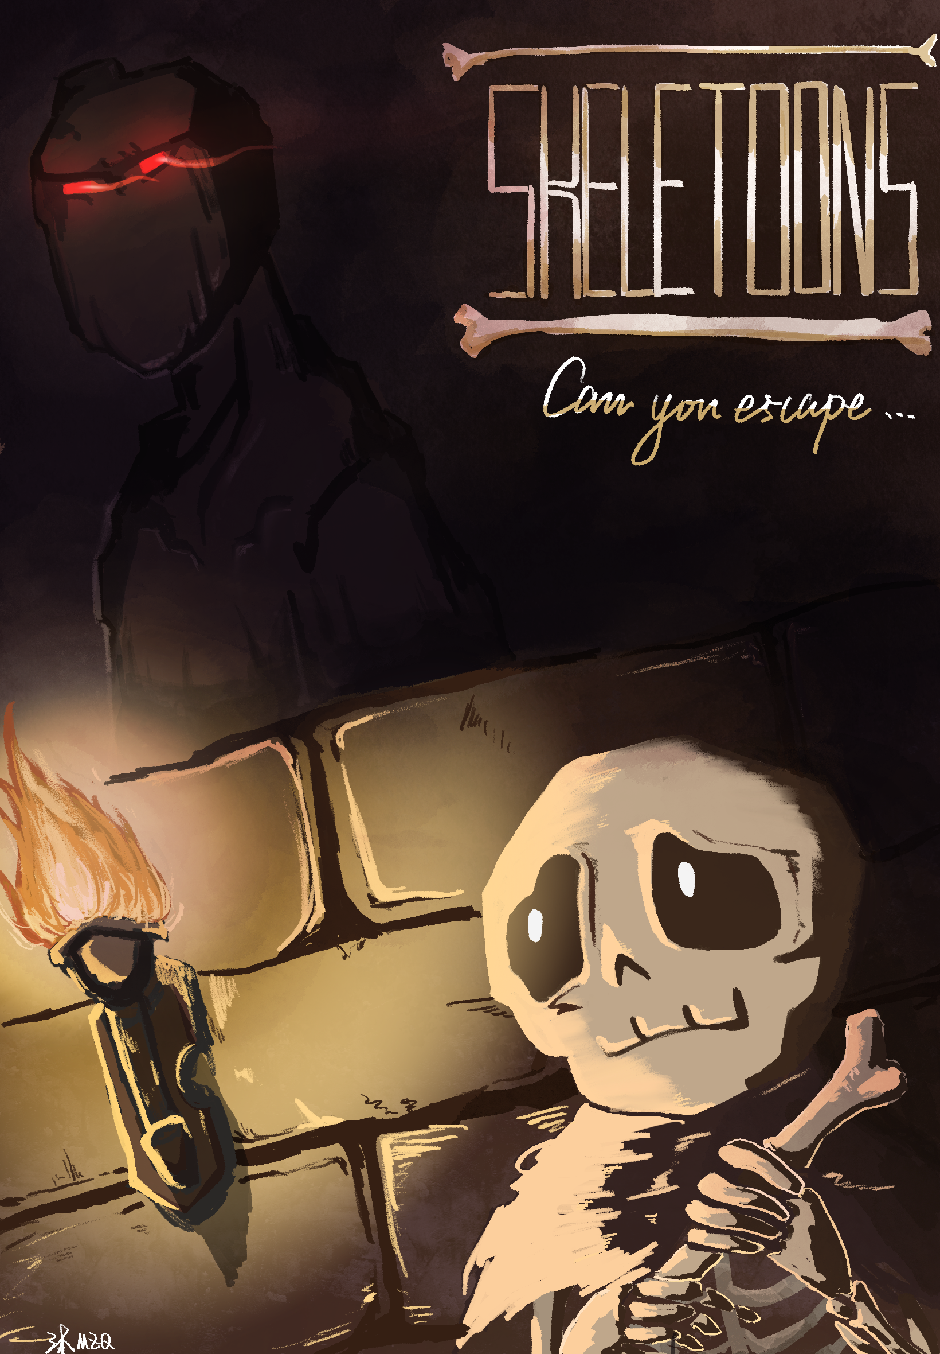
Level Engineering
SKELETOONS
Jonas Niewöhner . Lara Liebmann . Leon Stier . Okay Ünal
Music by: Lukas & Arezou

Slide 2
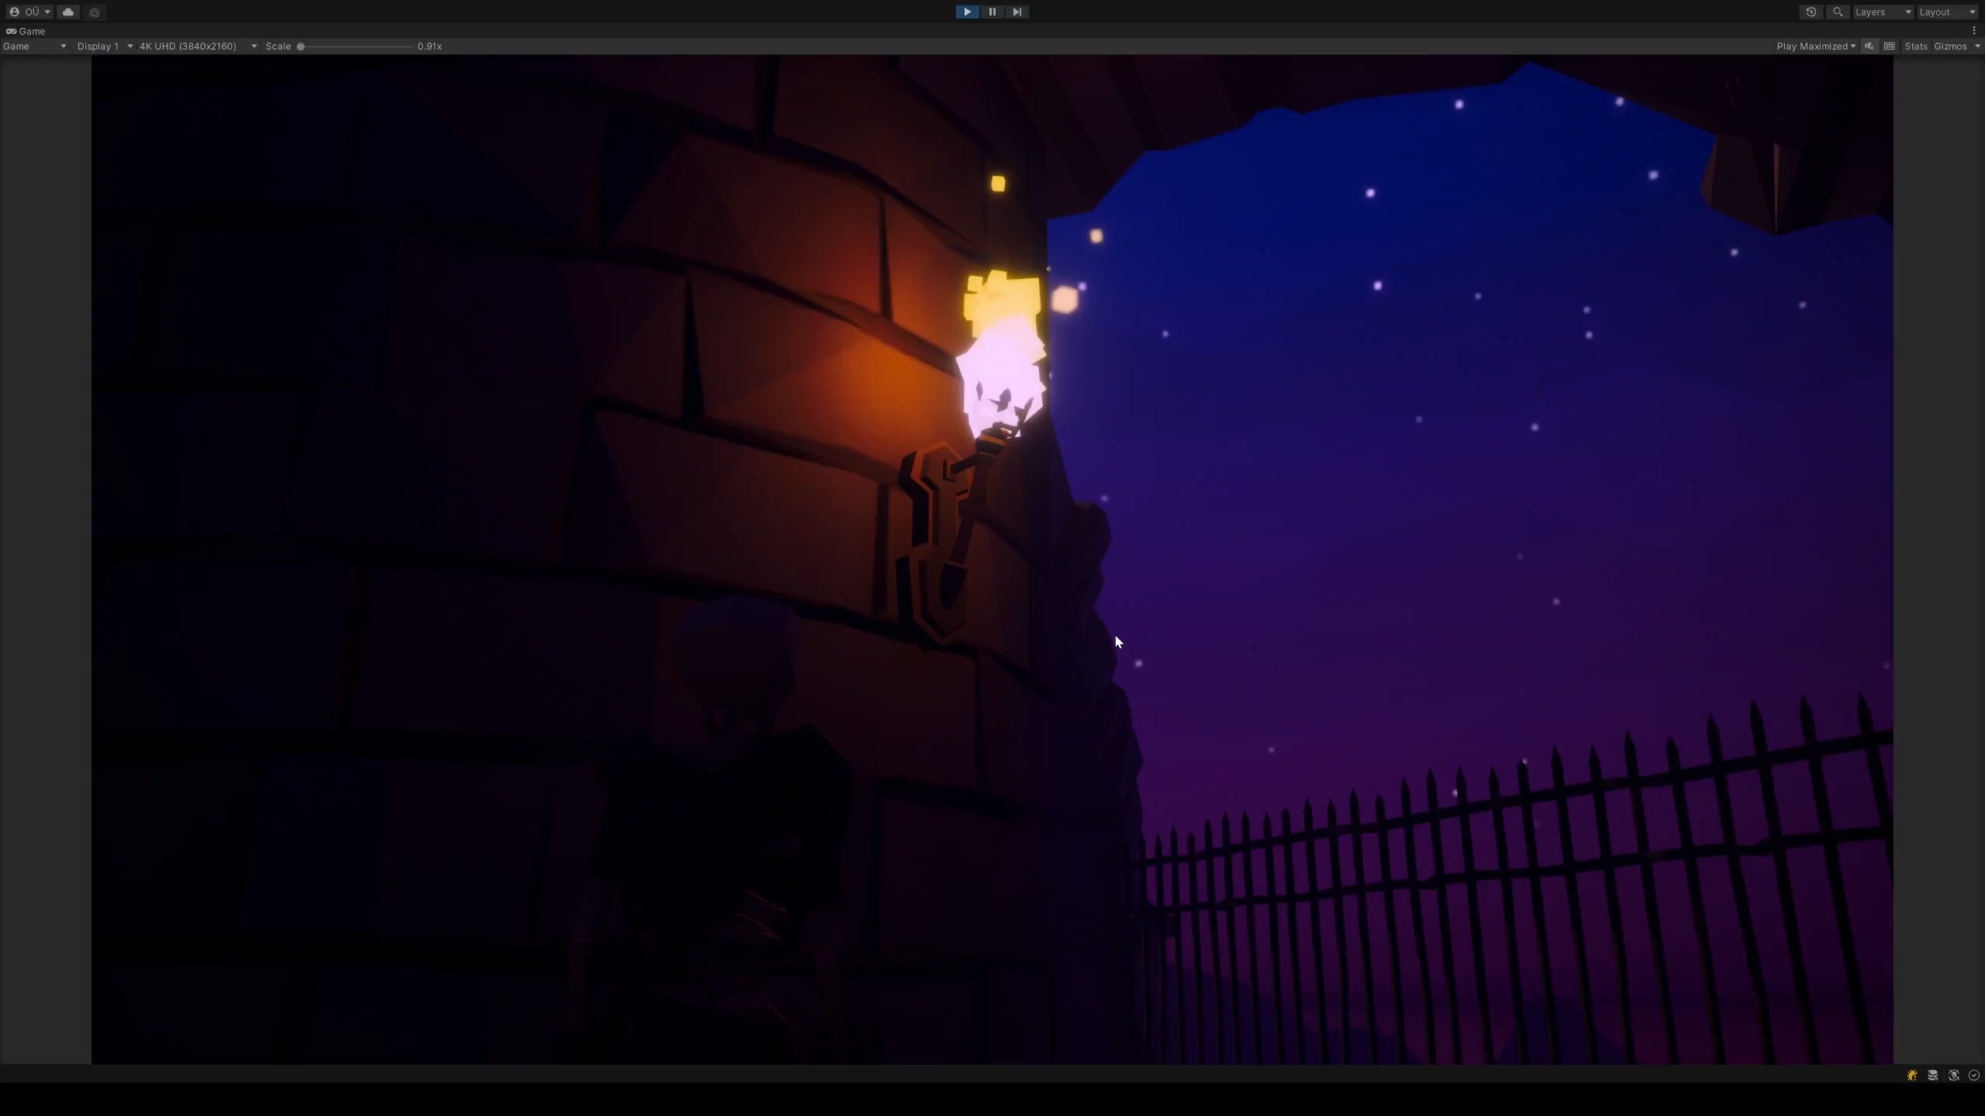
Gameplay

Slide 3
Development Process - Jonas
Underground Level
Balance Herausforderung / Einführung
Schwierigkeit: Kein natürliches Licht

Slide 4
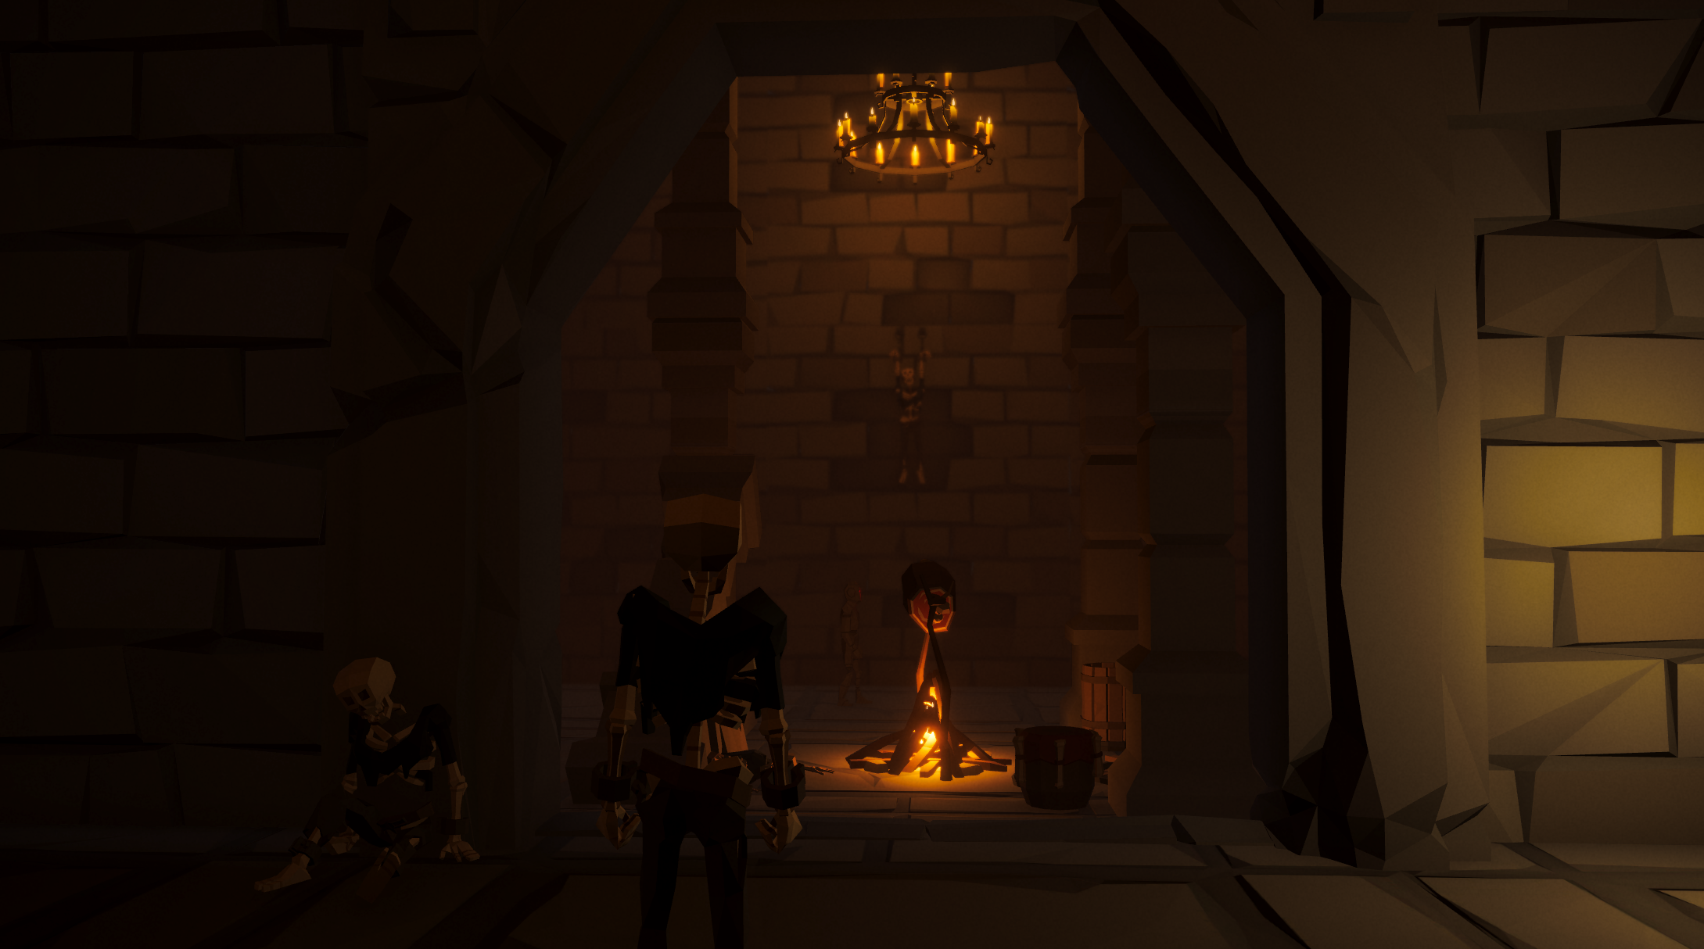
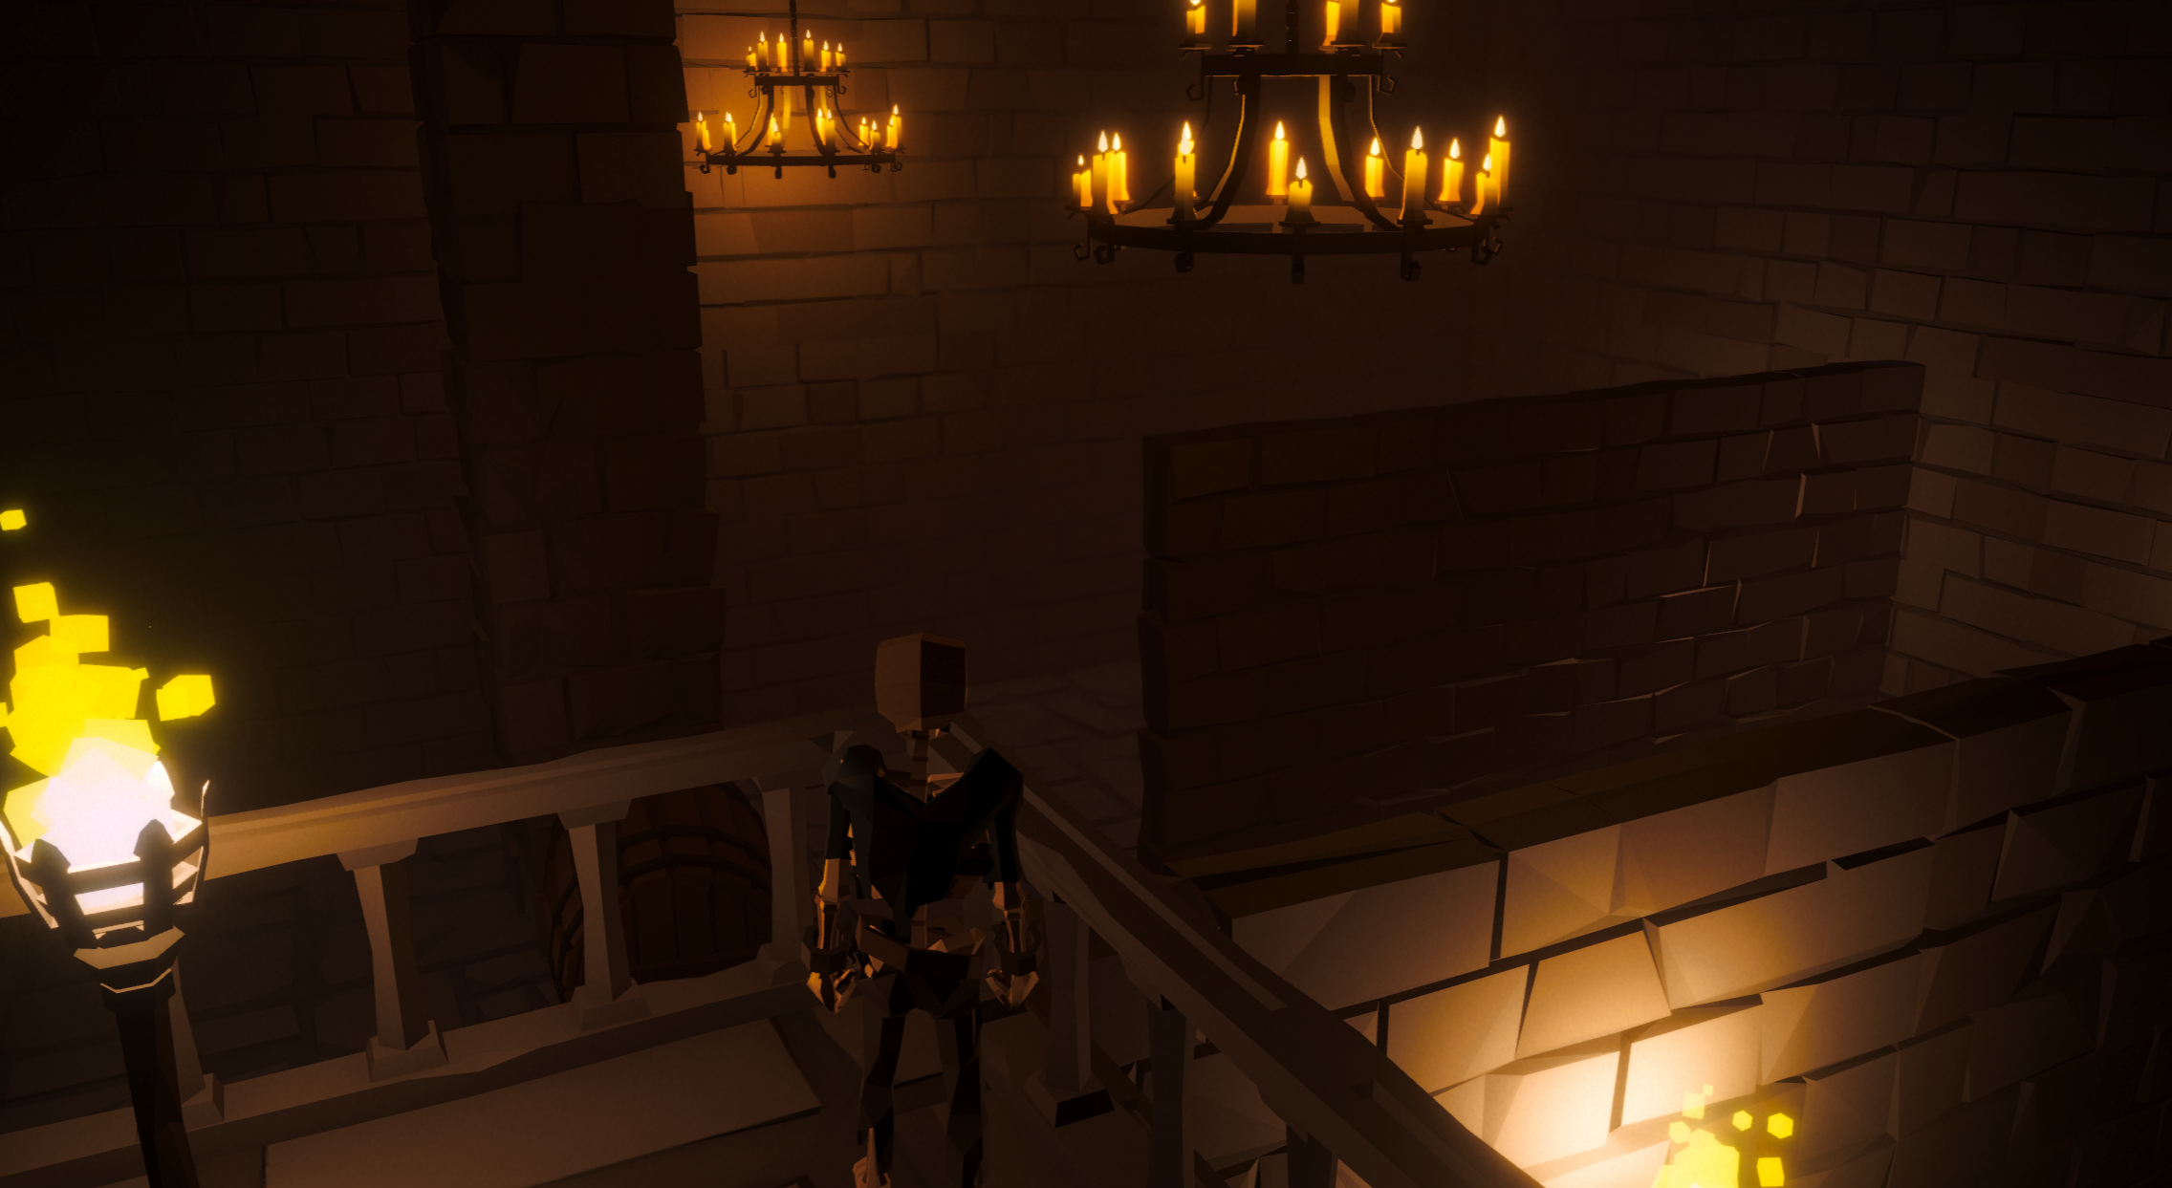
Dungeon Level - Jonas

Slide 5
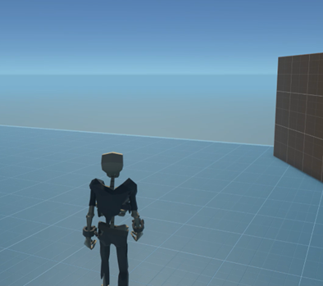
Character Controller - Jonas
Third Person
Walk / Jump / Sneak / Run
Werfen

Slide 6
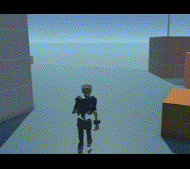
Character Controller - Jonas
Third Person
Walk / Jump / Sneak / Run
Werfen

Slide 7
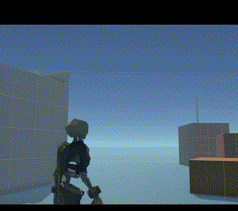
Character Controller - Jonas
Third Person
Walk / Jump / Sneak / Run
Werfen

Slide 8
Development Process - Lara
Castle Level
Interactables

Slide 9
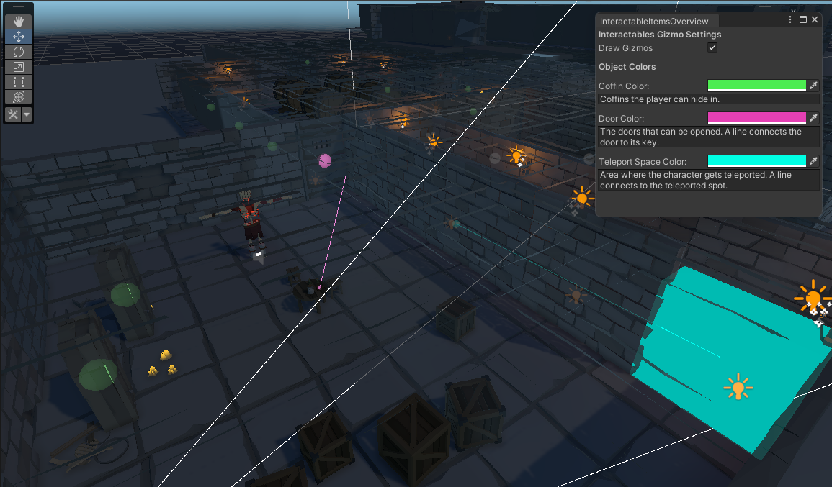
Interactive Level Objects
Door and its key
Teleportation Area
Lockers to hide in

Slide 10
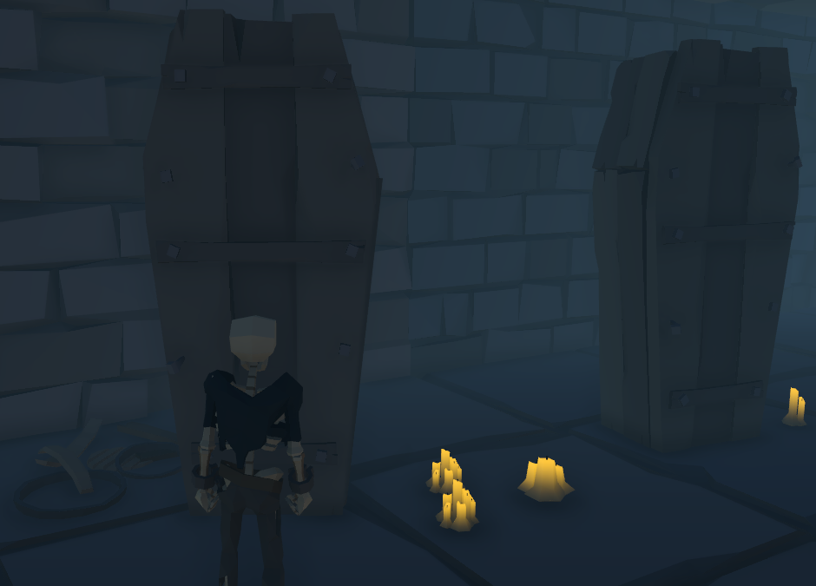
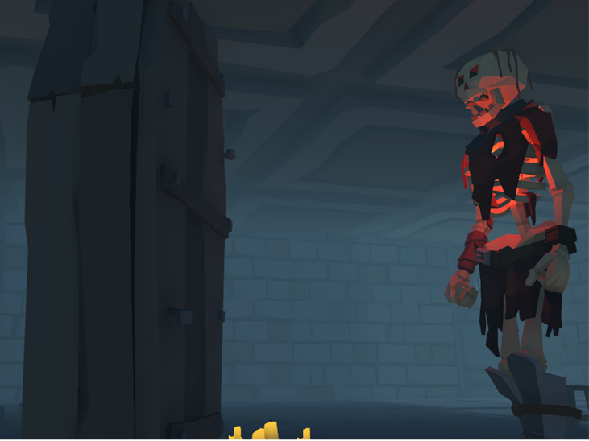
Hide from Enemies
Enemies can't detect the hidden player
The player can enter coffins in the level to hide

Slide 11
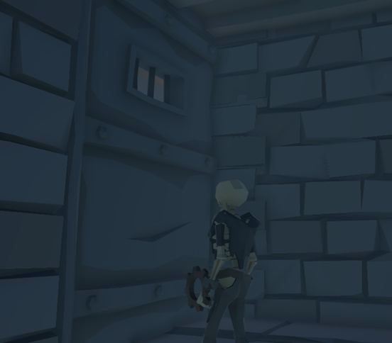
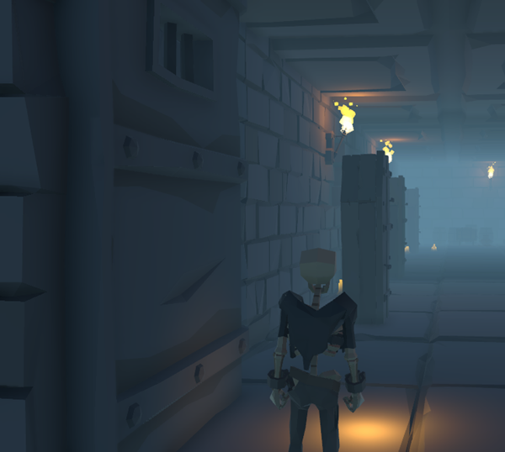
Hide from Enemies
Open doors with their key
Collect an item and carry it

Slide 12
Development Process - Okay
Castleyard Level
Enemy AI

Slide 13
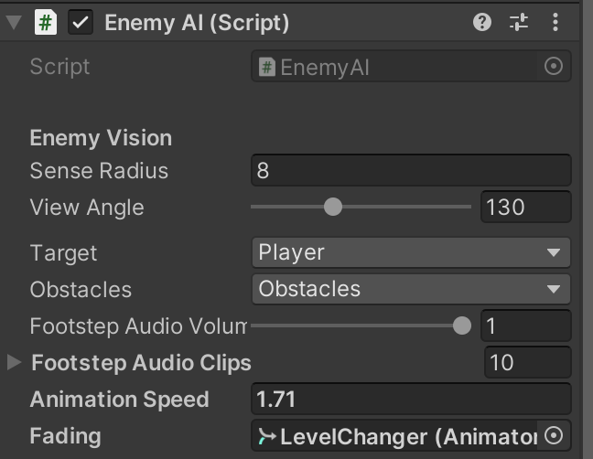
Enemy AI – Core AI and Tool Development
Navmesh Agents
Path specified with Tool
Various Parameter to define
Layer to find Player
Layer to define Objects behind which Player can hide

Slide 14
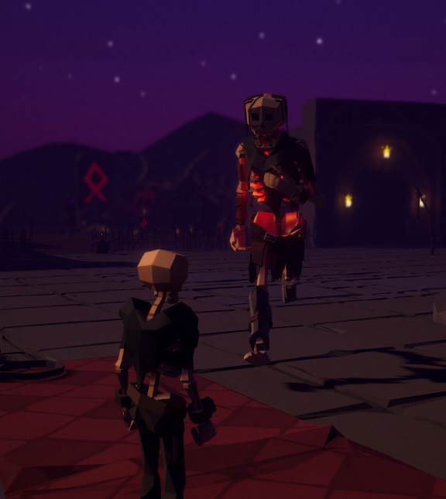
Enemy AI - Behaviour
Walk Path
Scout for Player on Waypoints (Rotate/Look Around)
If sees Player, catch Player
No chance to escape Enemy
Level restarts

Slide 15
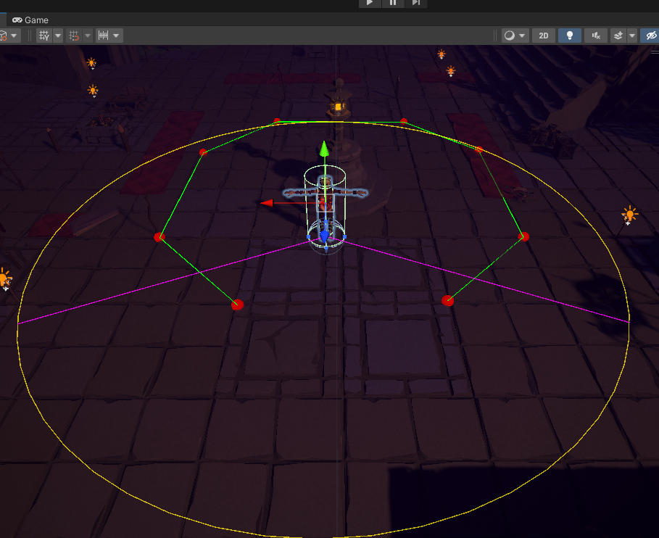
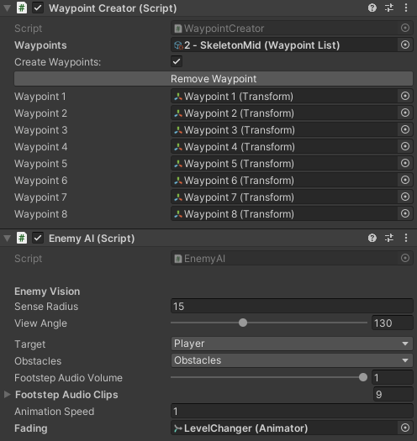
Enemy AI – Visualisation in Scene

Slide 16
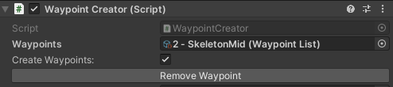
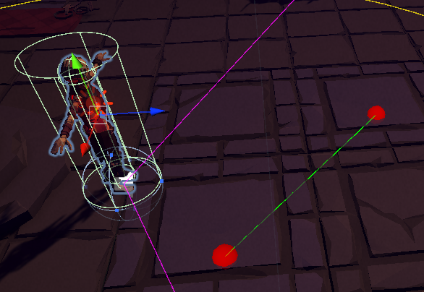

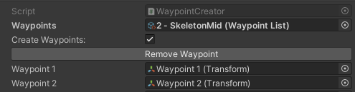
Enemy AI Tool – Intuitive Path Creator
Draw the path of Enemies by clicking it into the scene
Create Scriptable Object to store Path informations
Enable toggle → Leftclick in the Scene View to create a Waypoint

Slide 17
Development Process - Leon
Garden Level
Puzzle
Wallplacer Tool

Slide 18
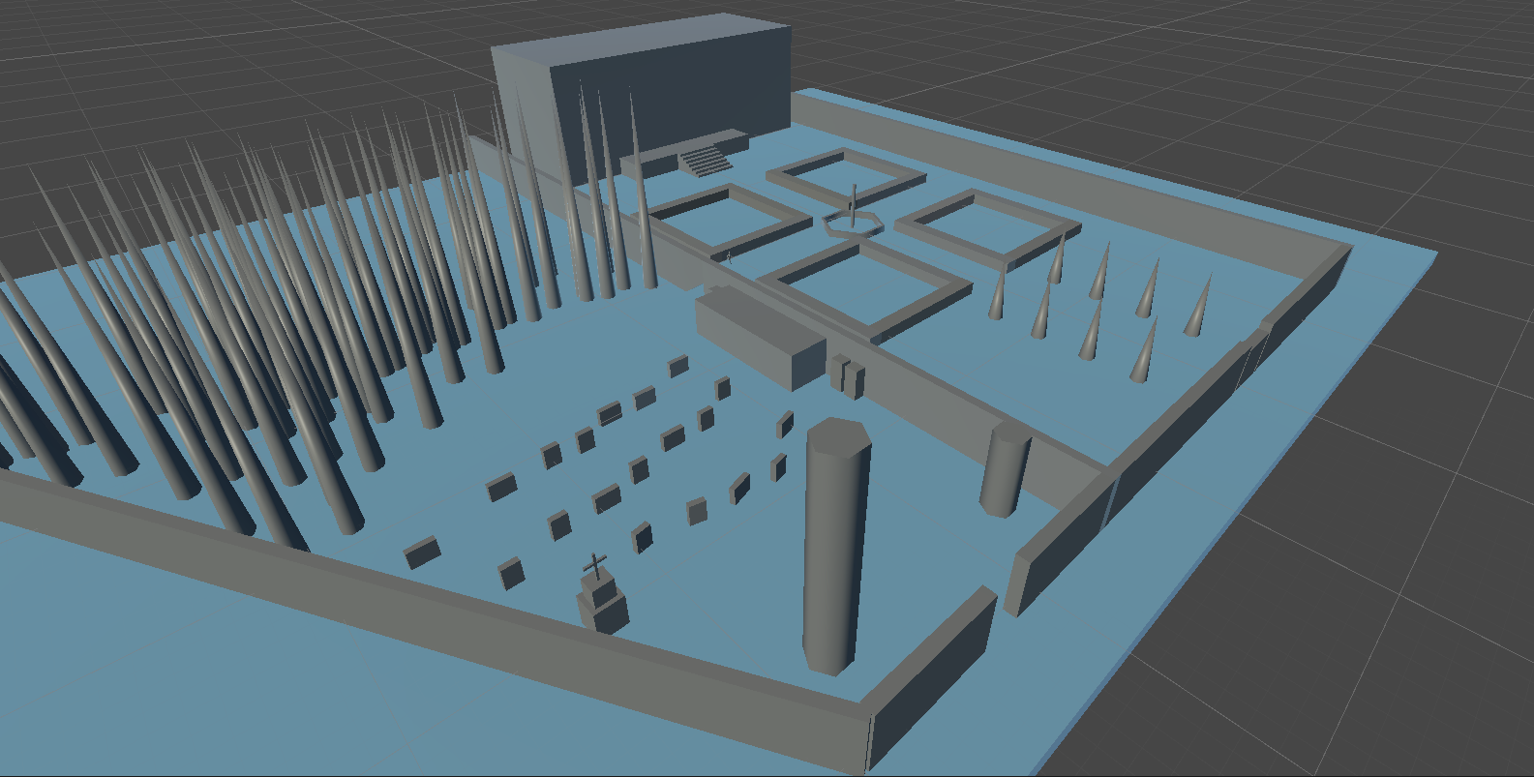
Level Iteration & Patterns
Verticality
Graveyard is downhill from garden
Learning by doing
Hiding in coffins
Entry hidden from view
Multiple Paths
Distract enemies vs. Sneak around
Hide in coffins vs. Hide behind gravestones

Slide 19
Tool Development: Wall Placer
Problem: Building Walls takes too much time
Cause: Need to build Wall one object at a time
Solution – Wall Placer Tool:
Choose Object to place
Define Start point (by clicking in the scene)
Define End point
Tool fills connecting line with Walls (or other objects)
Supports snapping

Slide 20
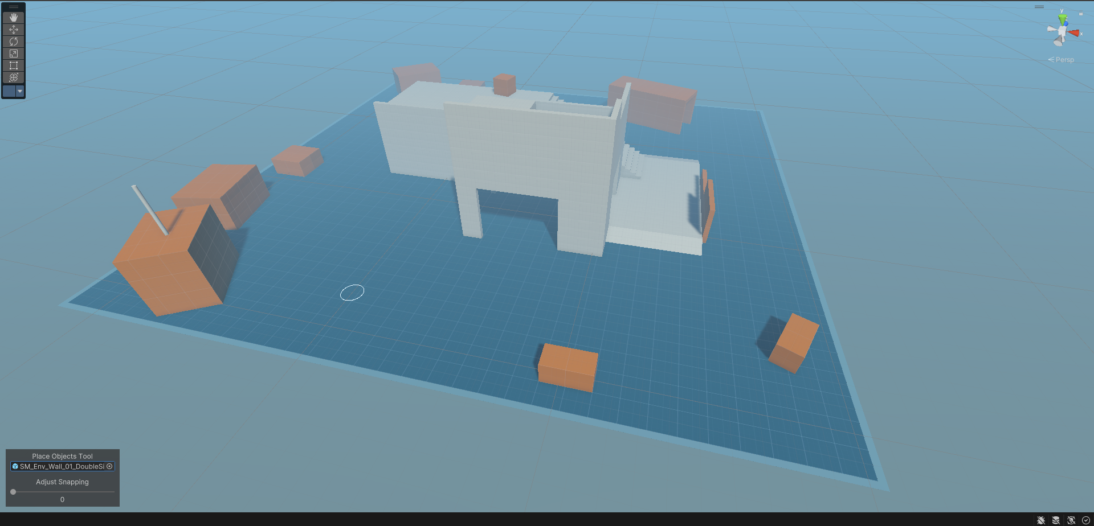
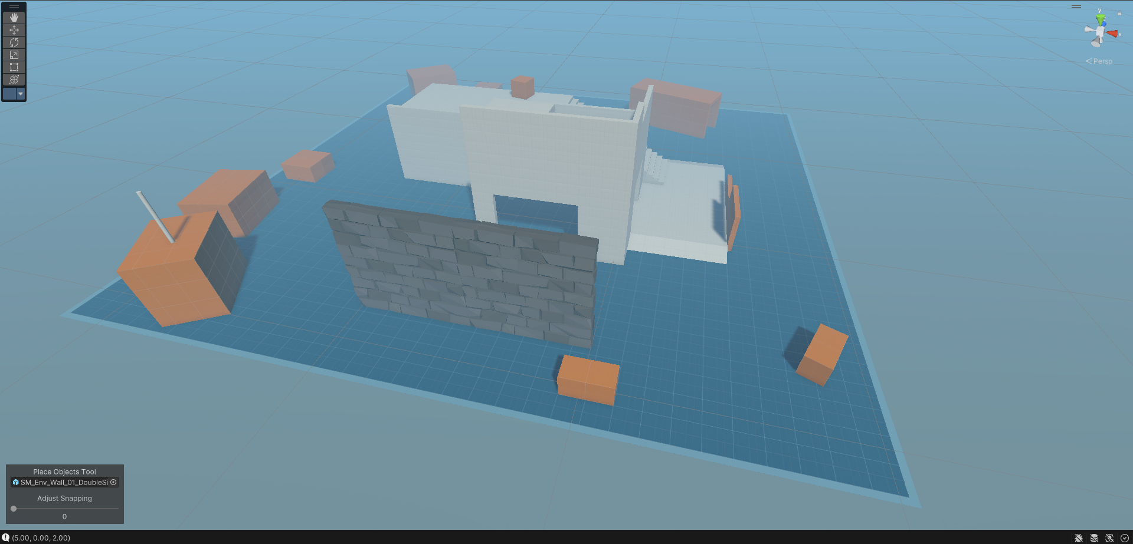
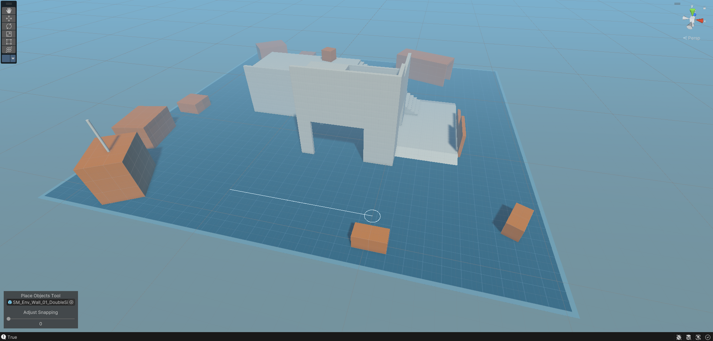
Tool Development: Wall Placer

Slide 21
Music Pieces

